Slide 1

Image Segmentation via UNet

Slide 2
Presentation Summary
Background
Approach
Set-up
Model
Loss Function
Results
Notes:
In this presentation, we will be introducing to you,
the background and motivation of this project
The approaches we took to achieve our objectives.
And our results.

Slide 3
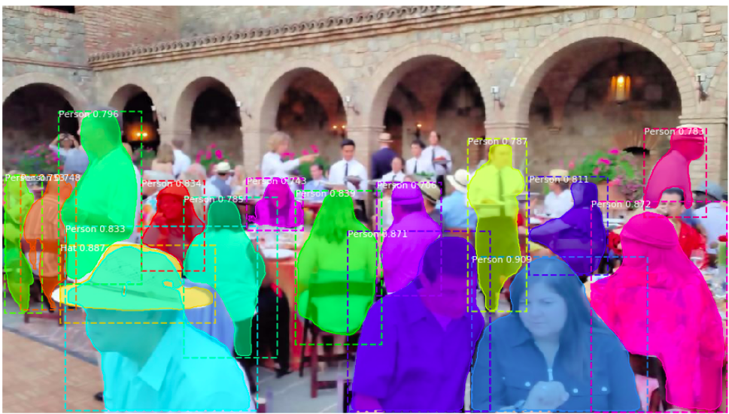
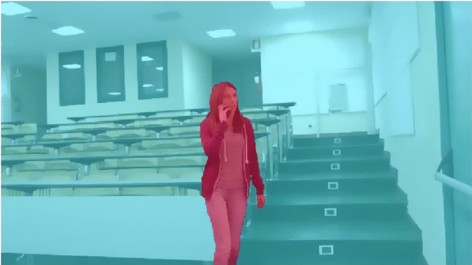
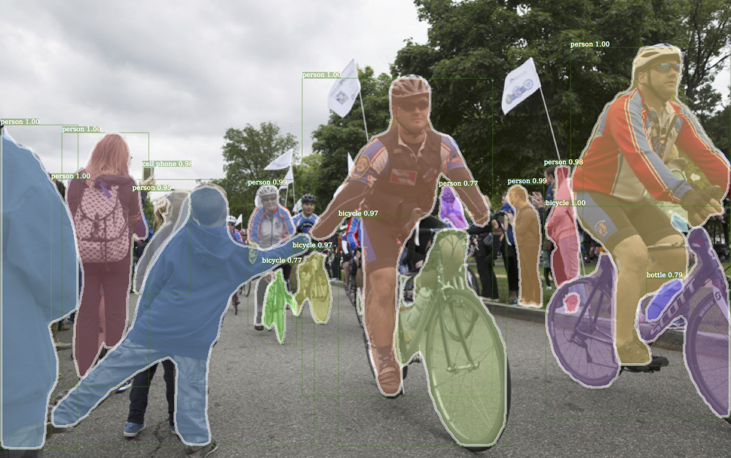
Background
Applications:
Surveillance Systems
Guidance Camera for Autonomous Driving
Medical Imaging
People Counting & Flow control
[3]
[2]
[1]
Notes:
One of the many computer vision algorithms that are changing our daily lives, image segmentation, is showing great potentials for many applications.
Instead of categorizing an object in an image, Image segmentation focuses more on locating specific objects in the image.
Some of the many applications of image segmentations are:
Surveillance System,
Guidance camera in autopilot,
Medical imaging,
Traffic flow control.
Reference: https://link.springer.com/article/10.1007/s11042-020-09425-0

Slide 4
Approach: Set-up
Hardware: NVIDIA GeForce RTX 2060, Intel(R) Core(™) i7-9700 CPU @ 3.00GHz
Platform: Windows 10 conda environment
Framework: python=3.8 cuda=11.3 PyTorch=1.11.0 opencv=4.0.1 For detail framework please visit out github ./conda_environment.yml
Dataset: PennFudanPed [5]
Functionalities: Detect Human
Limitations: Accuracy drops when real-world data implemented.
Notes:
For this project we utilized a NVIDIA RTX 2060 GPU and an Intel i7 CPU, running a WIndows 10 conda environment
We used python 3.8, cuda 11.3, pytorch 1.11.0 and opencv 4.0.1 as our frame,
The Penn-Fudan Database for Pedestrian Detection and Segmentation as our dataset.
Dataset: https://www.kaggle.com/datasets/jiweiliu/pennfudanped?select=readme.txt

Slide 5
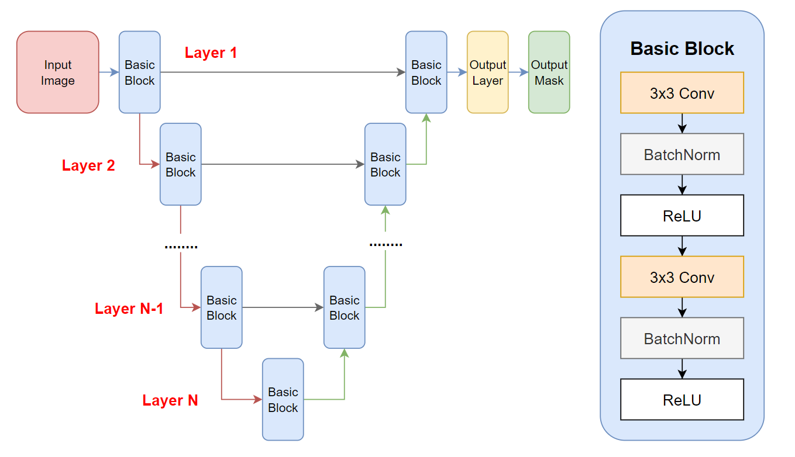
Approach: UNet Model
Fig 1. Model Overview
Notes:
Figure 1 gives us an overview of the U-Net Model.

Slide 6
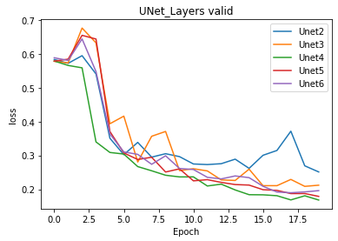
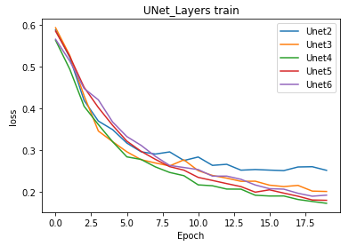
Approach: Simply stacking more layers?
“Overly deep” Network might have higher training and validation errors
Too many Layers will cause Model Overfitting
As the result, we pick UNet 4-Layer to train our dataset.
Fig 2. UNet_Layers valid
Fig 3. UNet_Layers train
Notes:
“Overly deep” Network might have higher training and validation errors

Slide 7
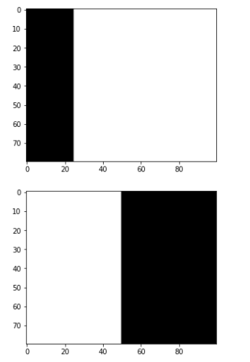
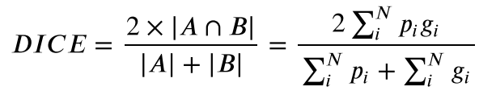
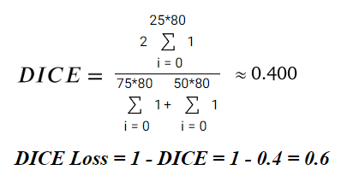
Approach: Loss Function
pi=0.75
DICE Loss = 1 - DICE
Example:
gi=0.5
Fig 4. DICE visualized
Notes:
In this project, we used DICE Loss as model criterion. Dice Loss is widely used in image segmentation tasks to address the data imbalance problem.
The Dice coefficient is a measure of the similarity between two set of data, and in our case, how closely predicted masking overlaps (aka union) labeled masking.
And then, the dice loss is simply one minus dice coefficient.
As we look at figure 3 for an example, image height is 80 and width is 100, we take 2*0.25 / (.75+.5) = .5/1.25= 0.4

Slide 8
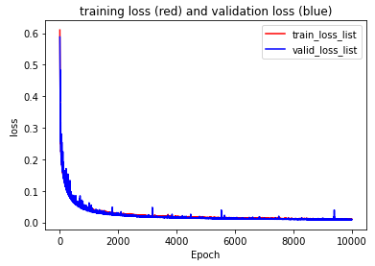
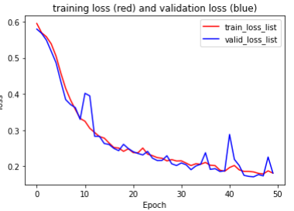
Result: Loss
Fig 5. DICE visualized
Notes:
Our training and validation soft-dice losses over epoch times are recorded in figure 5.
Since we consider small validation loss as our metric of high model performance, we are observing higher and higher image segmentation accuracy as training progresses.
We are eventually able to decrease our validation dice loss to 0.009 after 10,000 epoch.

Slide 9
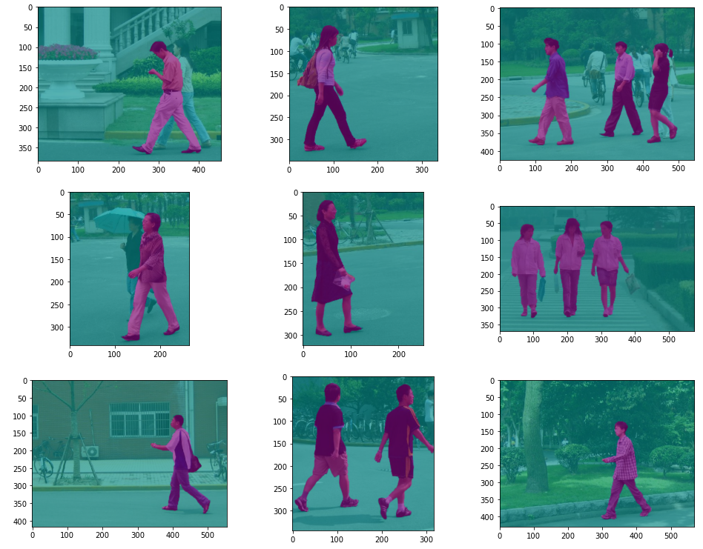
Result
Fig 6. Visualized Results
Notes:
Finally, figure 6 visualizes our model’s outputs.
After we succeeded in reducing our soft dice loss a sufficiently low value, our model is able to accurately locate the pedestrians in each image,
As well as precisely determining the outlines of each pedestrian.

Slide 10
Reference
Project GitHub repo with documented code
https://github.com/popkarthb/UNet-Image-Segmentation-Deep-Learning
[1] Gruosso, Monica, et al. “Human Segmentation in Surveillance Video with Deep Learning.” SpringerLink, Springer US, 6 Sept. 2020, https://link.springer.com/article/10.1007/s11042-020-09425-0.
[2]He, Kaiming. “CVPR'17 Tutorial on Deep Learning for Objects and Scenes.” CVPR'17 Tutorial, http://deeplearning.csail.mit.edu/slide_cvpr2018/laurens_cvpr18tutorial.pdf.
[3] “Detectron.” Meta AI, https://ai.facebook.com/tools/detectron/.
[4] Ronneberger, Olaf, et al. “U-Net: Convolutional Networks for Biomedical Image Segmentation.” ArXiv.org, 18 May 2015, https://arxiv.org/abs/1505.04597.
[5]Wang, Liming, et al. “Penn-Fudan Database for Pedestrian Detection and Segmentation.” Pedestrian Detection Database, University of Pennsylvania, Fudan University, Jan. 2007, https://www.cis.upenn.edu/~jshi/ped_html/.
Notes:
Here is a link to our Github repository as well as our references.
Thank you for listening and
Shu and I will be very happy to answer any questions you have.

